Slide 1
UNIT 1: Machine Learning Foundation (Lecture 4)

Slide 2
TASK 1:
A hospital uses an AI model to detect COVID-19.
Total patients tested = 200
Actual COVID-positive patients = 50
The model correctly identified 45 COVID-positive patients
The model wrongly predicted 20 healthy patients as COVID-positive
Questions
Construct the confusion matrix
Calculate Accuracy
Calculate Precision
Calculate Recall
Calculate F1-Score

Slide 3
TP = 45
FN = 50 − 45 = 5
FP = 20
TN = 200 − (45 + 5 + 20) = 130
 | Predicted Positive | Predicted Negative
Actual Positive | 45 (TP) | 5 (FN)
Actual Negative | 20 (FP) | 130 (TN)

Slide 4
Accuracy = (45 + 130) / 200 = 87.5%
Precision = 45 / (45 + 20) = 69.2%
Recall = 45 / (45 + 5) = 90%
F1-Score = 78.3%

Slide 5
TASK 2:
An ML model predicts whether a student will Pass an exam.
Total students = 150
Actual Pass = 90
Actual Fail = 60
Correctly predicted Pass = 75
Incorrectly predicted Pass = 15

Slide 6
TP = 75
FP = 15
FN = 90 − 75 = 15
TN = 60 − 15 = 45

Slide 7
TASK 3:
A bank detects Fraudulent transactions.
Total transactions = 1000
Actual fraud cases = 80
Correctly detected fraud = 60
False alarms (normal marked as fraud) = 40

Slide 8
TP = 60
FN = 80 − 60 = 20
FP = 40
TN = 1000 − (60 + 20 + 40) = 880

Slide 9
Overfitting and Underfitting:
Underfitting → Model is too simple, didn’t learn enough
Overfitting → Model is too complex, learned too much (including noise)
Underfitting
A student:
Studies only headings
Doesn’t understand concepts
→ Performs poorly in both class tests and final exam
Overfitting
A student:
Memorizes exact questions
Learns answers word-by-word
→ Performs great in class tests, bad in final exam
Good Fit
A student:
Understands concepts
Can solve new questions
→ Performs well everywhere

Slide 10
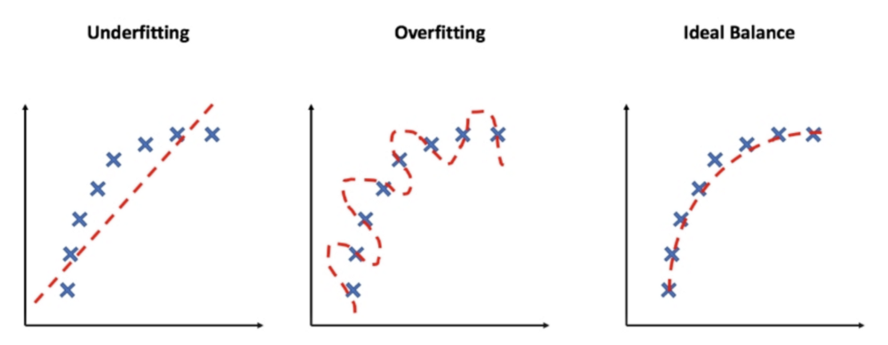

Slide 11
Underfitting:
What happens?
Model is too simple
Cannot capture the data pattern
Causes
Too few features
Model too basic (e.g., linear model for complex data)
Not enough training time
Signs
Low accuracy
High error on both training & test data

Slide 12
Overfitting:
What happens?
Model learns noise + outliers
Fits training data too perfectly
Causes
Too many features
Very complex model
Small dataset
Signs
Very low training error
High test error

Slide 13
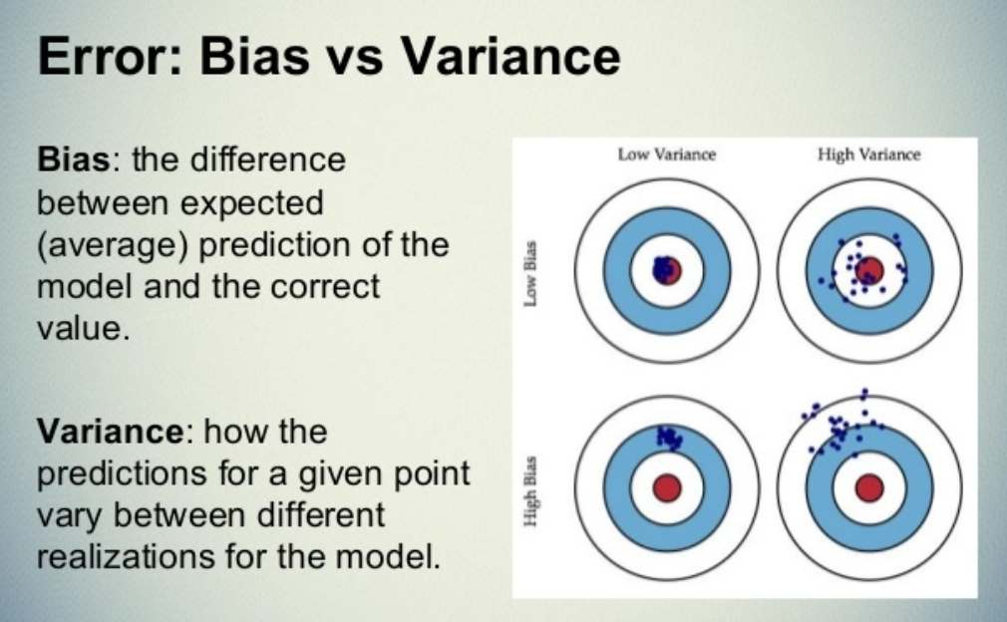

Slide 14
What is Bias–Variance Trade-off?
→ The Bias–Variance Trade-off is the balance between underfitting and overfitting.
You cannot minimize bias and variance at the same time improving one usually worsens the other.
Simple Intuition
High Bias → Model too simple → Underfitting
High Variance → Model too complex → Overfitting
→ Goal: Find the sweet spot where total error is minimum.

Slide 15
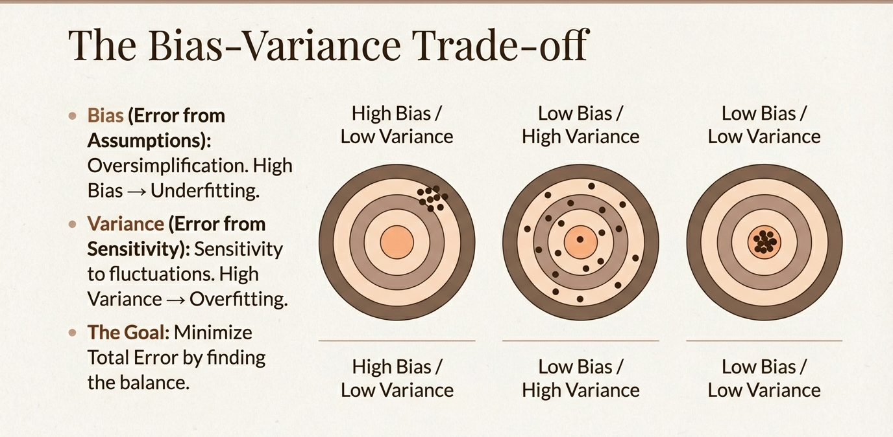

Slide 16
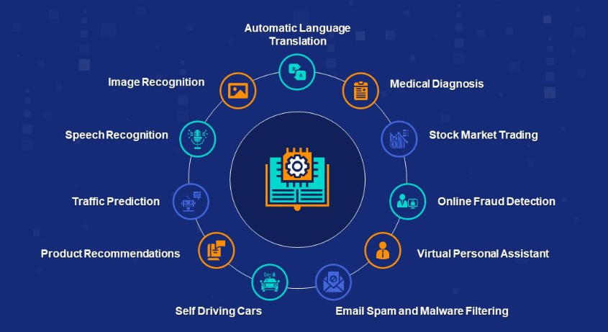
Applications and Use-cases of ML:

